Slide 1
MULTI-CUT REBAR(16)
Advisor : Prof. K.C.Chang
Presenters : You-Ran Nai
Notes:
Try 講清楚脈絡

Slide 2

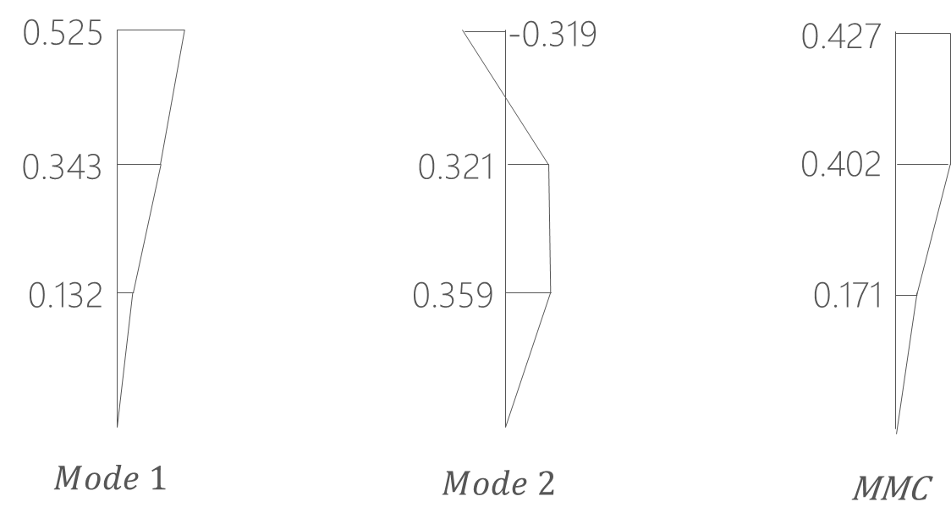
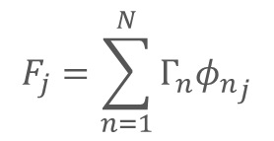
Pushover Load Pattern
Triangle
Multi-Modes Combination
Modal Pushover Analysis
$$F_{j}=\sum_{n=1}^{N}{Γ_{n}{φ_{n}}_{j}}$$
SRSS
Notes:
定義非線性驗證的邊界

Slide 3
MMC

Slide 4
Normal Two

Slide 5
Ra=1.98
R=2.20
Ra=2.02
R=2.25
Ra=0.38
R=0.46

Slide 6
Normal Multi
Ra=1.77
R=1.98

Slide 7
Ra=1.72
R=1.93
Ra=1.77
R=1.98
Ra=0.3
R=0.36

Slide 8
Normal NoLd
Ra=1.57
R=1.76

Slide 9
Ra=1.72
R=1.93
Ra=1.77
R=1.98
Ra=0.3
R=0.36

Slide 10
Normal Side
Ra=1.56
R=1.74

Slide 11
Ra=1.61
R=1.80
Ra=1.66
R=1.84
Ra=0.3
R=0.36

Slide 12
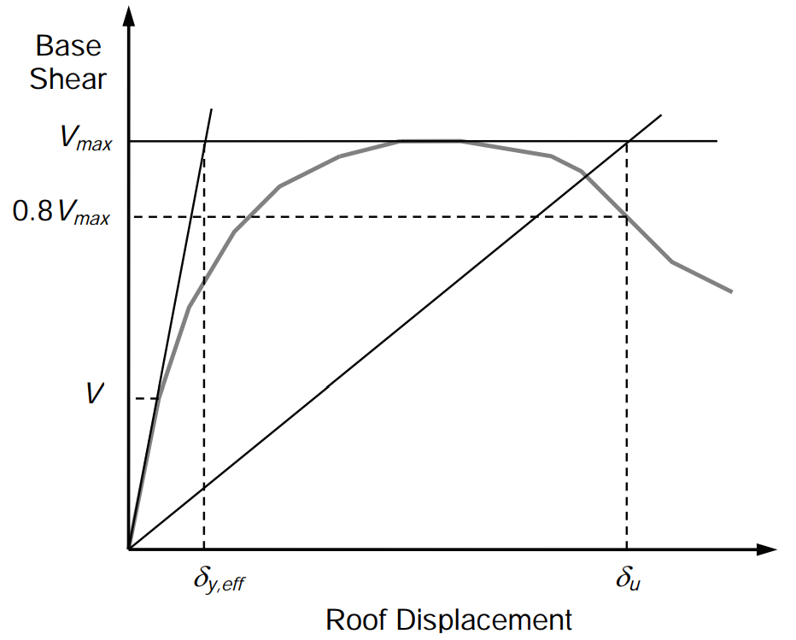
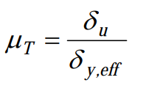
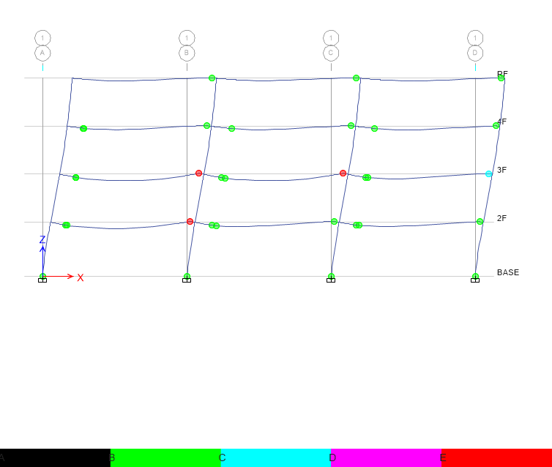
Pushover Result
Hinge
Notes:
比較 Ra, R 值
DBE, MCE 的性能績效點對應到 delta_u
雙線性化找到 delta_y,eff

Slide 13
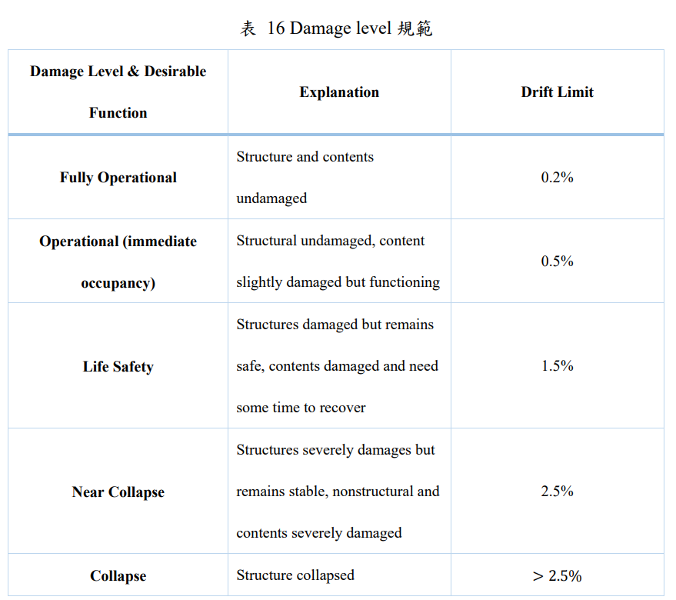
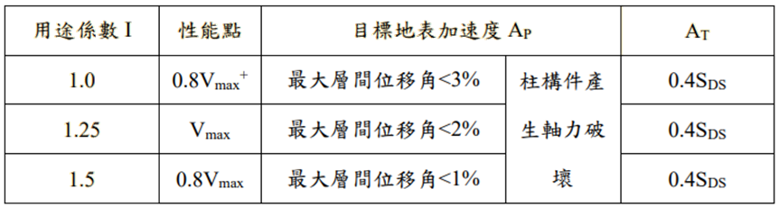
Pushover Result
耐震性能檢測 PGA
ATC-40

Slide 14
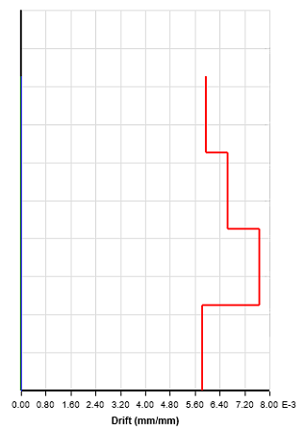
Time history
Story Drift
Scaled to DBE, MCE
DBE < 2%
MCE < 3%

Slide 15
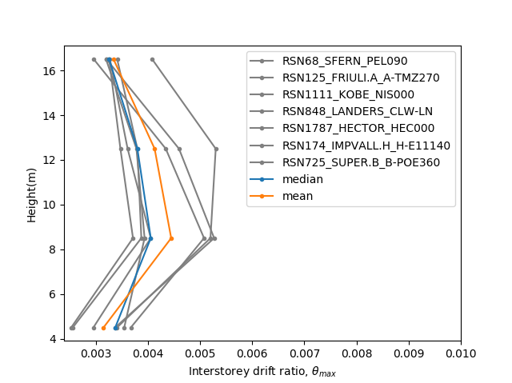
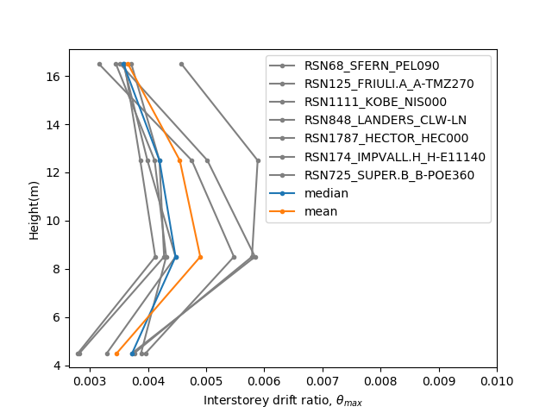
Two
0.0049
0.0044

Slide 16
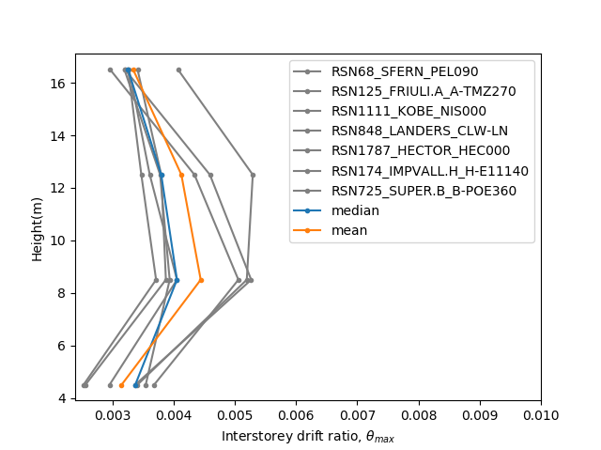

Normal Multi
0.0049
0.0044

Slide 17
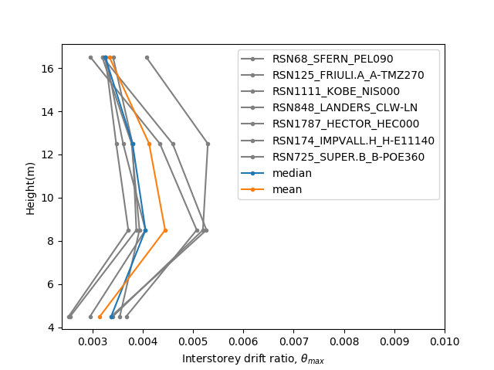
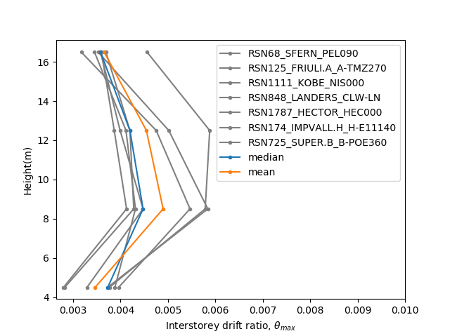
Normal NoLd
0.0049
0.0044

Slide 18
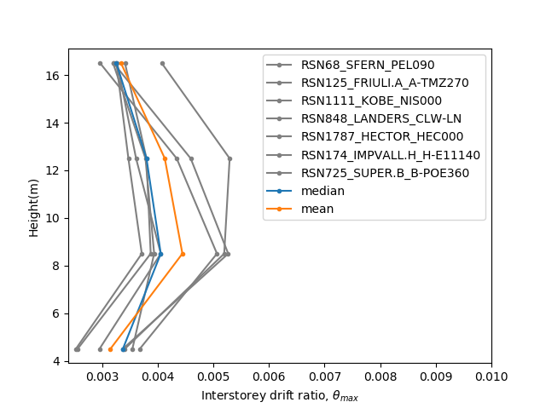

Normal Side

Slide 19
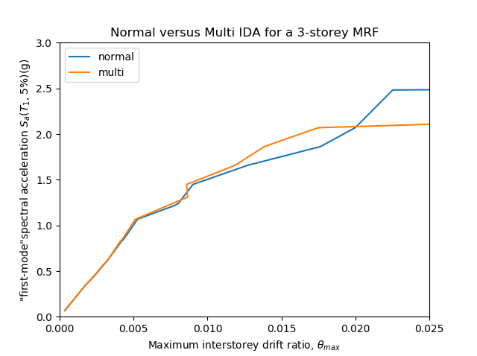
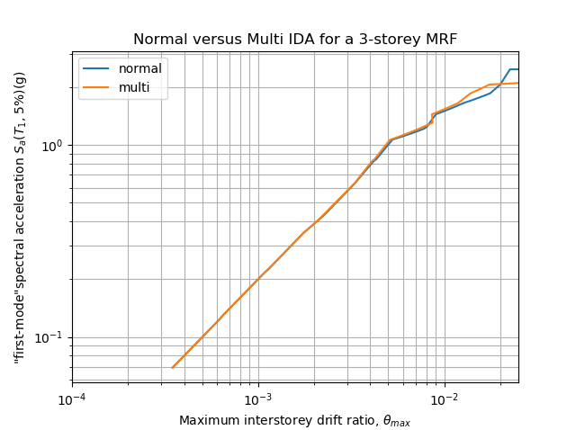
IDA
Limit-State
4% FEMA273
2.5% SEAOC 2000

Slide 20
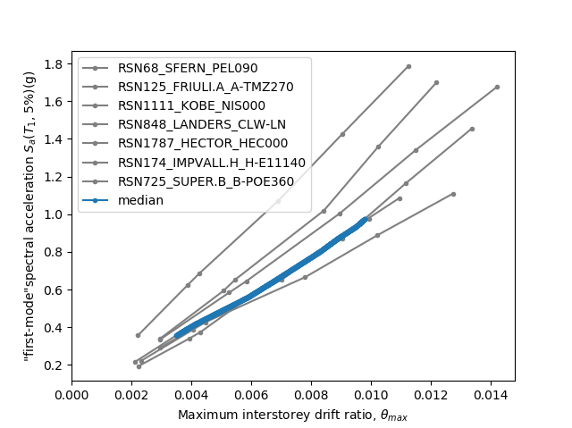
Normal Two

Slide 21
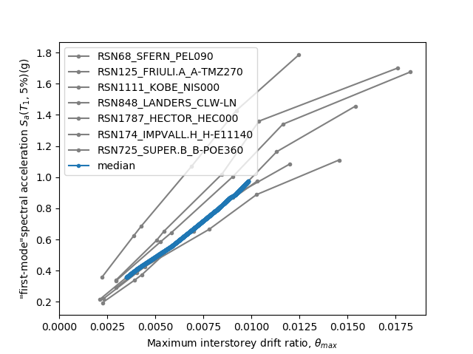
Normal Multi

Slide 22

Normal NoLd

Slide 23
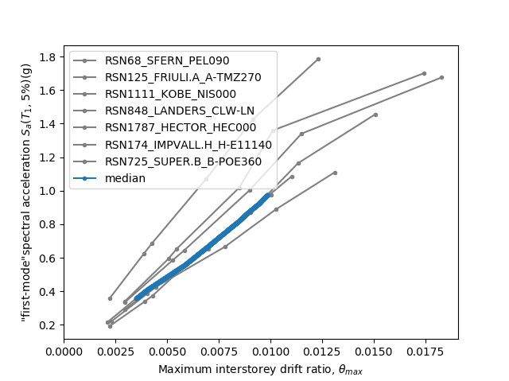
Normal Side

